Slide 1
Models of Abnormality

Slide 2
Models of Abnormality
In science, the perspectives used to explain events are known as models or paradigms
Each spells out basic assumptions, gives order to the field under study, and sets guidelines for investigation
Models influence what investigators observe, the questions they ask, the information they seek, and how they interpret this information

Slide 3
Models of Abnormality
Historically, clinical scientists of a given place and time tended to agree on a single model of abnormality – a model greatly influenced by the beliefs of their culture
Today, several models are used to explain and treat abnormal functioning
Each model focuses on one aspect of human functioning and no single model can explain all aspects of abnormality

Slide 4
The Biological Model
Adopts a medical perspective
Main focus is that psychological abnormality is an illness brought about by malfunctioning parts of the organism
Typically focused on the brain

Slide 5
How Do Biological Theorists Explain Abnormal Behavior?
Brain anatomy
The brain is composed of ~100 billion nerve cells (called neurons) and thousands of billions of support cells (called glia)
Within the brain, large groups of neurons form distinct areas called brain regions

Slide 6
How Do Biological Theorists Explain Abnormal Behavior?
Brain anatomy and abnormal behavior
Clinical researchers have discovered connections between certain psychological disorders and problems in specific brain areas
Example: Huntington’s disease and basal ganglia (forebrain)

Slide 7
How Do Biological Theorists Explain Abnormal Behavior?
Brain chemistry
Information is communicated throughout the brain in the form of electrical impulses that travel from one neuron to one (or more) others
An impulse first is received at a neuron’s dendrites, travels down the axon, and is transmitted to other neurons through the nerve endings

Slide 8
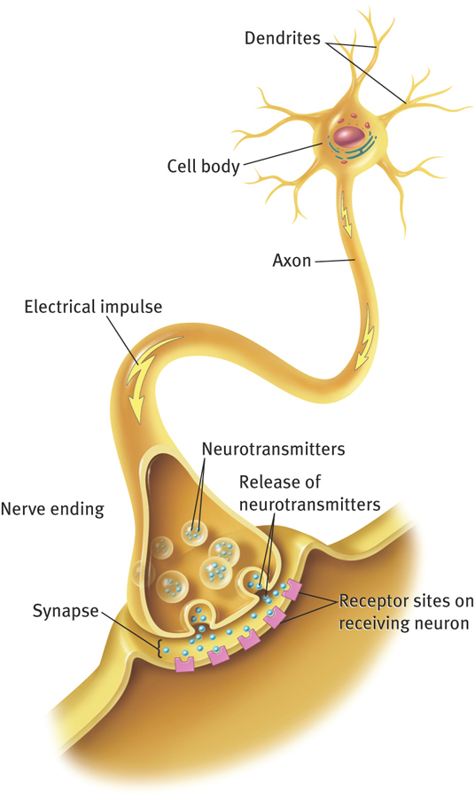
8

Slide 9
How Do Biological Theorists Explain Abnormal Behavior?
Brain chemistry
Neurons do not actually touch each other; they are separated by a space (the synapse), across which a message moves
When an electrical impulse reaches a nerve ending, the ending is stimulated to release a chemical called a neurotransmitter (NT), that travels across the synaptic space to receptors on the dendrites of neighboring neurons
Some NTs tell receiving neurons to “fire;” other NTs tell receiving neurons to stop firing

Slide 10
How Do Biological Theorists Explain Abnormal Behavior?
Brain chemistry and abnormal behavior
Researchers have identified dozens of NTs
Examples: serotonin, dopamine, and GABA
Studies indicate that abnormal activity in certain NTs can lead to specific mental disorders
Examples: depression (serotonin and norepinephrine) and anxiety (GABA)

Slide 11
How Do Biological Theorists Explain Abnormal Behavior?
Brain chemistry and abnormal behavior
Additionally, researchers have learned that mental disorders are sometimes related to abnormal chemical activity in the endocrine system
Endocrine glands release hormones which propel body organs into action. Abnormal secretions have been linked to psychological disorders
Example: cortisol release is related to anxiety and mood disorders

Slide 12
How Do Biological Theorists Explain Abnormal Behavior?
Sources of biological abnormalities – genetics
Each cell in the human body has 23 pairs of chromosomes, each with numerous genes that control the characteristics and traits a person inherits
Studies suggest that inheritance plays a part in mood disorders, schizophrenia, Alzheimer’s disease, and other mental disorders
Are not able (yet) to identify specific genes
Do not know the extent to which genetic factors contribute to disorders
Appears that in most cases several genes combine to produce our actions and reactions

Slide 13
How Do Biological Theorists Explain Abnormal Behavior?
Sources of biological abnormalities – viral infections
Another possible source of abnormal brain structure or biochemical dysfunction is viral infection
Example: schizophrenia and prenatal viral exposure
Interest in viral explanations of psychological disorders has been growing in the past decade
Example: Intellectual Disability

Slide 14
Biological Treatments
Biological practitioners attempt to pinpoint the physical source of dysfunction to determine the course of treatment
Three types of biological treatment:
Drug therapy
Electroconvulsive therapy (ECT)
Neurosurgery

Slide 15
Assessing the Biological Model
Strengths:
Enjoys considerable respect in the field
Constantly produces valuable new information
Brings great relief
Weaknesses:
Evidence is incomplete or inconclusive
Treatments produce significant undesirable (negative) effects

Slide 16
The Psychodynamic Model
Oldest and most famous psychological model
Based on belief that a person’s behavior (whether normal or abnormal) is determined largely by underlying dynamic psychological forces of which she or he is not consciously aware
Abnormal symptoms are the result of conflict among these forces
Father of psychodynamic theory and psychoanalytic therapy:
Sigmund Freud (1856–1939)

Slide 17
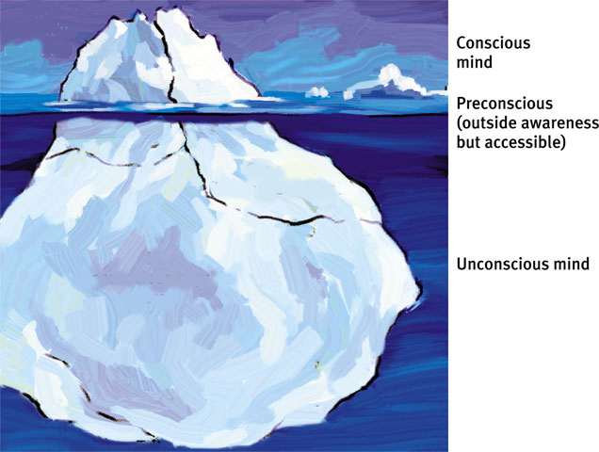
Model of Mind
The mind is like an iceberg. It is mostly hidden, and below the surface lies the unconscious mind. The preconscious stores temporary memories.

Slide 18
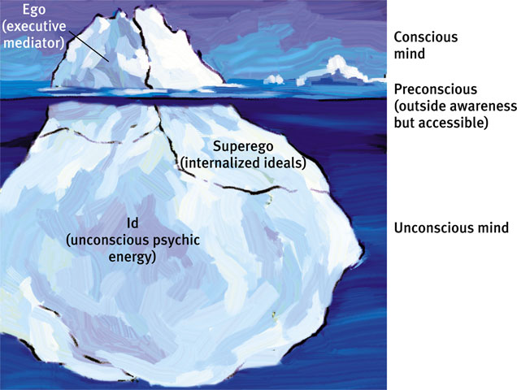
Personality Structure
Personality develops as a result of our efforts to resolve conflicts between our biological impulses (id) and social restraints (superego).

Slide 19
Id, Ego and Superego
The Id unconsciously strives to satisfy basic sexual and aggressive drives, operating on the pleasure principle, demanding immediate gratification.
The ego functions as the “executive” and mediates the demands of the id and superego.
The superego provides standards for judgment (the conscience) and for future aspirations.

Slide 20
Personality Development
Freud believed that personality formed during the first few years of life divided into psychosexual stages. During these stages the id’s pleasure-seeking energies focus on pleasure sensitive body areas called erogenous zones.
Notes:
OBJECTIVE 5| Identify Freud’s psychosexual stages of development, and describe the effects of fixation on behavior.

Slide 21
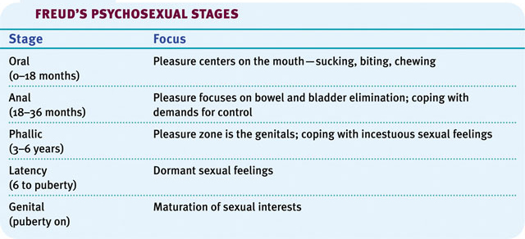
Psychosexual Stages
Freud divided the development of personality into five psychosexual stages.

Slide 22
Oedipus Complex
A boy’s sexual desire for his mother and feelings of jealousy and hatred for the rival father. A girl’s desire for her father is called the Electra complex.

Slide 23
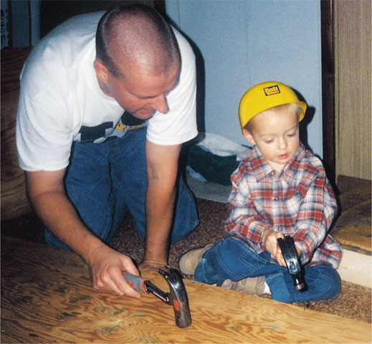
Identification
Children cope with threatening feelings by repressing them and by identifying with the rival parent. Through this process of identification, their superego gains strength that incorporates their parents’ values.
From the K. Vandervelde private collection

Slide 24
Defense Mechanisms
The ego’s protective methods of reducing anxiety by unconsciously distorting reality.
1. Repression banishes anxiety-arousing thoughts, feelings, and memories from consciousness.
2. Regression- leads to an infantile stage
Notes:
OBJECTIVE 6| Describe the function of defense mechanisms, and identify six of them.
Defense mechanisms reduce or redirect anxiety in various ways, but always by distorting reality. Repression, which underlies the other defense mechanisms, banishes anxiety-arousing thoughts from consciousness; regression involves retreat to an earlier, more infantile stage of development; and reaction formation makes unacceptable impulses look like their opposites. Projection attributes threatening impulses to others, rationalization offers self-justifying explanations for behavior, and displacement diverts impulses to a more acceptable object.

Slide 25
Defense Mechanisms
3. Reaction Formation causes the ego to unconsciously switch unacceptable impulses into their opposites.
4. Projection leads people to disguise their own threatening impulses by attributing them to others.
Notes:
Example of reaction formation- ego unconsciously makes unaccpetable impulses look like their opposites
“I hate him” becomes “I love him” People may express feelings of purity when they may be suffering anxiety from unconscious feelings about sex.

Slide 26
Defense Mechanisms
5. Rationalization offers self-justifying explanations
6. Displacement shifts sexual or aggressive impulses toward a more acceptable object
Notes:
Ratinalization occurs when we unconsciously generate self-justifying exoplanations to hide ourselves from the real treasons for our actions
Habitaul drinkers who drink with their friends “just to be sociable”
Students who fail to study may rationalize
in place of the real, more threatening, unconscious reasons for one’s actions.
or person, redirecting anger toward a safer outlet.

Slide 27
Do Now:
Bryce often acts so daring and overly confident that few people realize he is actually riddled with unconscious insecurity and self-doubt. Bryce best illustrates the use of a defense mechanism known as: a. regression. b. projection. c. displacement. d. reaction formation.
Jaydon doesn’t realize that his alcohol abuse and neglect of his family is leading to the destruction of both family and career. A psychoanalyst would suggest that Jaydon shows signs of a: a. strong ego. b. weak id. c. strong superego. d. weak ego
Bonnie is afraid to express anger at her overbearing and irritating supervisor at work, so she is critical of her children instead. A psychoanalyst would suggest that Bonnie’s reaction to her children illustrates: a. identification. b. reaction formation. c. displacement. d. projection.
Notes:
Freud's theories of Personality:
Id, Ego, Superego
Defense Mechanisms- in order to resolve the conflict between id and superego, we develop six defense mechanisms
repression-
rationalization-
regression-
reaction-
projection-
displacement-
question?
All very controversial
All published in "Interpretation of Dreams,"
What are some reasons why Freud might be controversial?

Slide 28
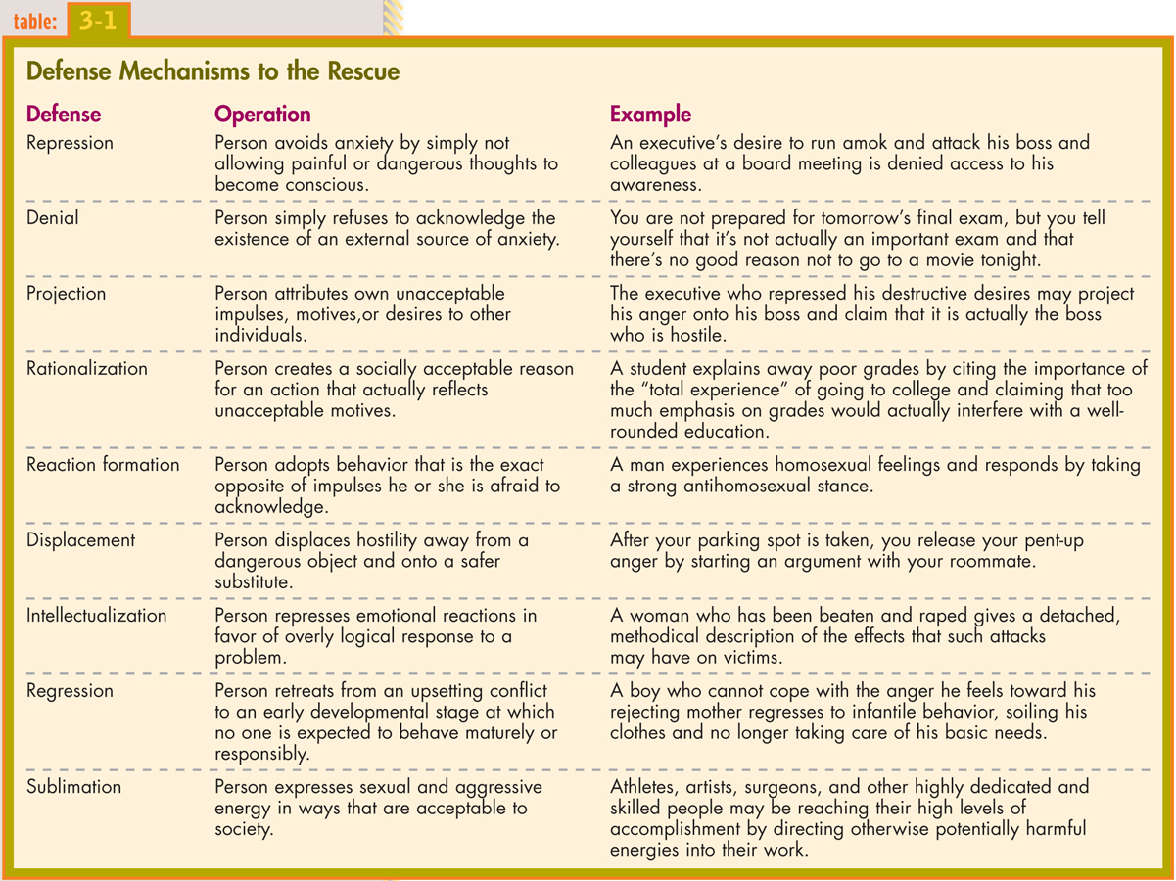

Slide 29
How Did Freud Explain Normal and Abnormal Functioning?
These three parts of the personality are often in some degree of conflict
A healthy personality is one in which compromise exists among the three forces
If the id, ego, and superego are in excessive conflict, the person’s behavior may show signs of dysfunction

Slide 30
Psychodynamic Therapies
Range from Freudian psychoanalysis to modern therapies
All seek to uncover past trauma and inner conflicts
Therapist acts as a “subtle guide”

Slide 31
Psychodynamic Therapies
Utilize various techniques:
Free association
Therapist interpretation
Resistance
Transference
Dream interpretation
Catharsis
Working through

Slide 32
Assessing the Psychodynamic Model
Strengths:
First to recognize importance of psychological theories and treatment
Saw psychological conflict as important source of psychological health and abnormality
First to apply theory and techniques systematically to treatment – monumental impact on the field
Weaknesses:
Unsupported ideas; difficult to research
Non-observable
Inaccessible to human subject (unconscious)

Slide 33
The Behavioral Model
Like psychodynamic theorists, behavioral theorists believe that our actions are determined largely by our experiences in life
Concentrates wholly on behaviors and environmental factors
Bases explanations and treatments on principles of learning

Slide 34
The Behavioral Model
The model began in laboratories where conditioning studies were conducted
Several forms of conditioning:
Operant conditioning
Modeling
Classical conditioning
All may produce normal or abnormal behavior

Slide 35
How Do Behaviorists Explain Abnormal Functioning?
Operant conditioning
Humans and animals learn to behave in certain ways as a result of receiving rewards whenever they do so

Slide 36
How Do Behaviorists Explain Abnormal Functioning?
Modeling
Individuals learn responses by observing and repeating behavior

Slide 37
How Do Behaviorists Explain Abnormal Functioning?
Classical conditioning
Learning by temporal association
When two events repeatedly occur close together in time, they become fused in a person’s mind; before long, the person responds in the same way to both events
Father of classical conditioning: Ivan Pavlov (1849 – 1936)
Classic study using dogs and meat powder
Explains many familiar behaviors (both normal and abnormal)

Slide 38
Classical Conditioning
US
Meat
UR
Salivate
US
Meat
Tone
UR
Salivate
+
CS
Tone
CR
Salivate

Slide 39
Behavioral Therapies
Aim to identify the behaviors that are causing problems and replace them with more appropriate ones
May use classical conditioning, operant conditioning, or modeling
Therapist is “teacher” rather than healer

Slide 40
Behavioral Therapies
Classical conditioning treatments may be used to change abnormal reactions to particular stimuli
Example: systematic desensitization for phobia
Step-by-step procedure
Learn relaxation skills
Construct a fear hierarchy
Confront feared situations

Slide 41
Assessing the Behavioral Model
Strengths:
Powerful force in the field
Can be tested in the laboratory
Significant research support for behavioral therapies
Weaknesses:
Too simplistic
Behavior therapy is limited
Downplays role of cognition
New focus on self-efficacy, social cognition, and cognitive-behavioral theories

Slide 42
The Cognitive Model
Seeks to account for behavior by studying the ways in which the person attends to, interprets, and uses available information
Argues that clinicians must ask questions about assumptions, attitudes, and thoughts of a client
Concerned with internal processes
Present-focused

Slide 43
How Do Cognitive Theorists Explain Abnormal Functioning?
Maladaptive thinking is the cause of maladaptive behavior
Several kinds of faulty thinking:
Faulty assumptions and attitudes
Illogical thinking processes
Example: overgeneralization

Slide 44
Cognitive Therapies
People can develop a new way of thinking to prevent maladaptive behavior
Main model: Beck’s Cognitive Therapy
The goal of therapy is to help clients recognize and restructure their thinking
Therapists also guide clients to challenge their dysfunctional thoughts, try out new interpretations, and apply new ways of thinking in their daily lives
Widely used in treating depression

Slide 45
Assessing the Cognitive Model
Strengths:
Very broad appeal
Clinically useful and effective
Focuses on a uniquely human process
Theories lend themselves to research
Therapies effective in treating several disorders
Weaknesses:
Singular, narrow focus
Overemphasis on the present

Slide 46
The Humanistic-Existential Model
Combination model
The humanist view
Emphasis on people as friendly, cooperative, and constructive; focus on drive to self-actualization
The existentialist view
Emphasis on self-determination, choice, and individual responsibility; focus on authenticity

Slide 47
Spiritual Views and Interventions
The historical alienation between the clinical field and religion seems to be ending
Researchers have learned that spirituality can, in fact, be of psychological benefit to people

Slide 48
Rogers’s Humanistic Theory and Therapy
Believes in the basic human need for unconditional positive regard
If received, leads to unconditional self-regard
If not, leads to “conditions of worth”
Incapable of self-actualization because of distortion – do not know what they really need, etc.
Rogers’s “client-centered” therapy
Therapist creates a supportive climate
Unconditional positive regard
Accurate empathy
Genuineness
Little research support

Slide 49
Existential Theories and Therapy
Belief that psychological dysfunction is caused by self-deception; people hide from life’s responsibilities and fail to recognize that it is up to them to give meaning to their lives
In therapy, people are encouraged to accept personal responsibility for their problems
Goals more important than technique
Great emphasis placed on client-therapist relationship

Slide 50
Assessing the Humanistic-Existential Model
Strengths:
Taps into domains missing from other theories
Emphasizes the individual
Optimistic
Emphasizes health
Weaknesses:
Focuses on abstract issues
Difficult to research
Not much influence
Weakened by disapproval of scientific approach
Changing somewhat

Slide 51
The Sociocultural Models
Argue that abnormal behavior is best understood in light of the social and cultural forces that influence an individual
Address norms and roles in society
Argue that we must examine a person’s social surroundings to understand his or her (abnormal) behavior

Slide 52
How Do Family-Social Theorists Explain Abnormal Functioning?
Focus on:
Social labels and roles
Diagnostic labels (example: Rosenhan study)
Sick role

Slide 53
Family-Social Treatments
This perspective has helped spur the growth of several treatment approaches, including:
Group therapy
Family therapy
Couple therapy
Community treatment
Includes prevention work

Slide 54
How Do Multicultural Theorists Explain Abnormal Functioning?
Culture refers to the set of values, attitudes, beliefs, history, and behaviors shared by a group of people and communicated from one generation to the next
The multicultural perspective has emerged as a growing field of study
Multicultural psychologists seek to understand how culture, race, ethnicity, gender, and similar factors affect behavior and thought, as well as how people of different cultures, races, and genders differ psychologically

Slide 55
How Do Multicultural Theorists Explain Abnormal Functioning?
Researchers have learned that psychological abnormality is more common among poorer people than among wealthier people
They also have noticed that the prejudice and discrimination faced by many minority groups may contribute to certain forms of abnormal functioning
Multicultural researchers also study differences that occur across countries as well as within countries

Slide 56
Multicultural Treatments
Studies have found that members of ethnic and racial minority groups tend to show less improvement in clinical treatment than members of majority groups
Inclusion of cultural models in treatment, especially in therapies for children and adolescents

Slide 57
Assessing the Sociocultural Models
Strengths:
Added greatly to the clinical understanding and treatment of abnormality
Increased awareness of labeling
Clinically successful when other treatments have failed
Weaknesses:
Research is difficult to interpret
Correlation ≠ causation

Slide 58
Integration of the Models
Each perspective is valuable to understanding abnormal behavior
Different perspectives are more appropriate under differing conditions
An integrative approach provides a general framework for thinking about abnormal behavior, and also allows for specification of the factors that are especially pertinent to particular disorders

Slide 59
Integration of the Models
Many theorists, clinicians, and practitioners adhere to a biopsychosocial model:
Abnormality results from the interaction of genetic, biological, developmental, emotional, behavioral, cognitive, social, and societal influences
Also popular:
Diathesis-stress approach
Diathesis = predisposition (bio, psycho, or social)

Slide 60
Integration of the Models
Integrative therapists are often called “eclectic” – taking the strengths from each model and using them in combination

